Slide 1

Chapter 3 & 4 Remedial Unix Shell & Working with Remote Machines
Bioinformatics Data Skills by Vince Buffalo
2017.10.04

Slide 2


Slide 3
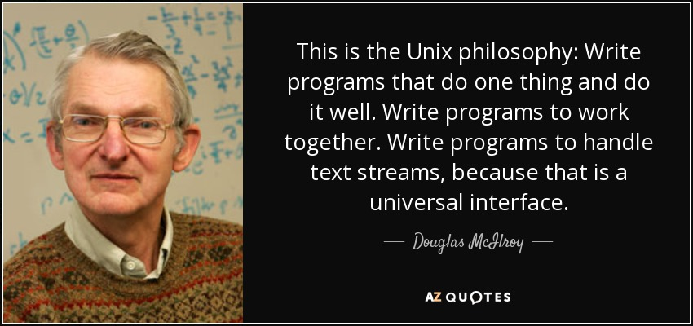

Slide 4




The modular approach of the Unix philosophy
Easier to spot errors and figure out where they’re.
Experiment with alternative methods and approaches.
Choose tools and languages that are appropriate for specific tasks.
Reusable and applicable to many types of data.

Slide 5
The Many Unix Shells
Make sure you’re using the Bourne-again shell, or bash.
You can run echo $SHELL to verify you’re using bash as your shell
it’s best to also check what echo $0
It’s possible to change your shell with the command chsh.

Slide 6
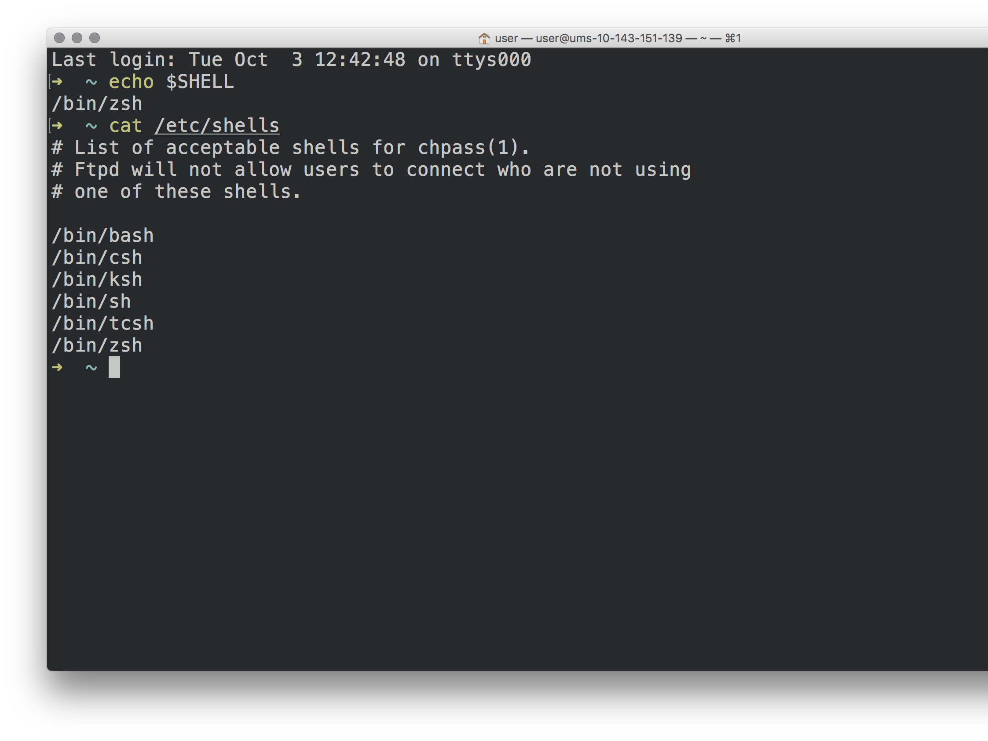

Slide 7
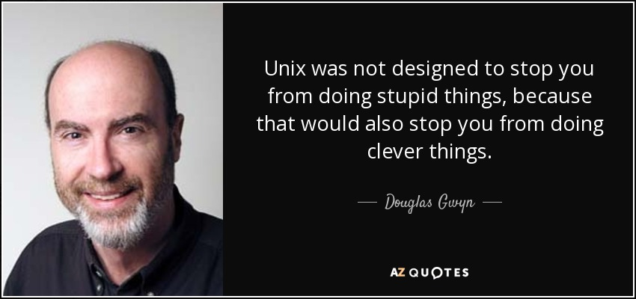
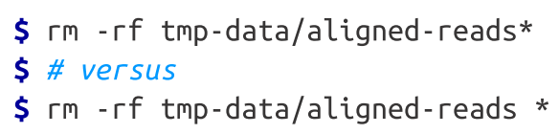

Slide 8

Working with Streams and Redirection
Text streams allow us to do processing on a stream of data rather than holding it all in memory

Slide 9
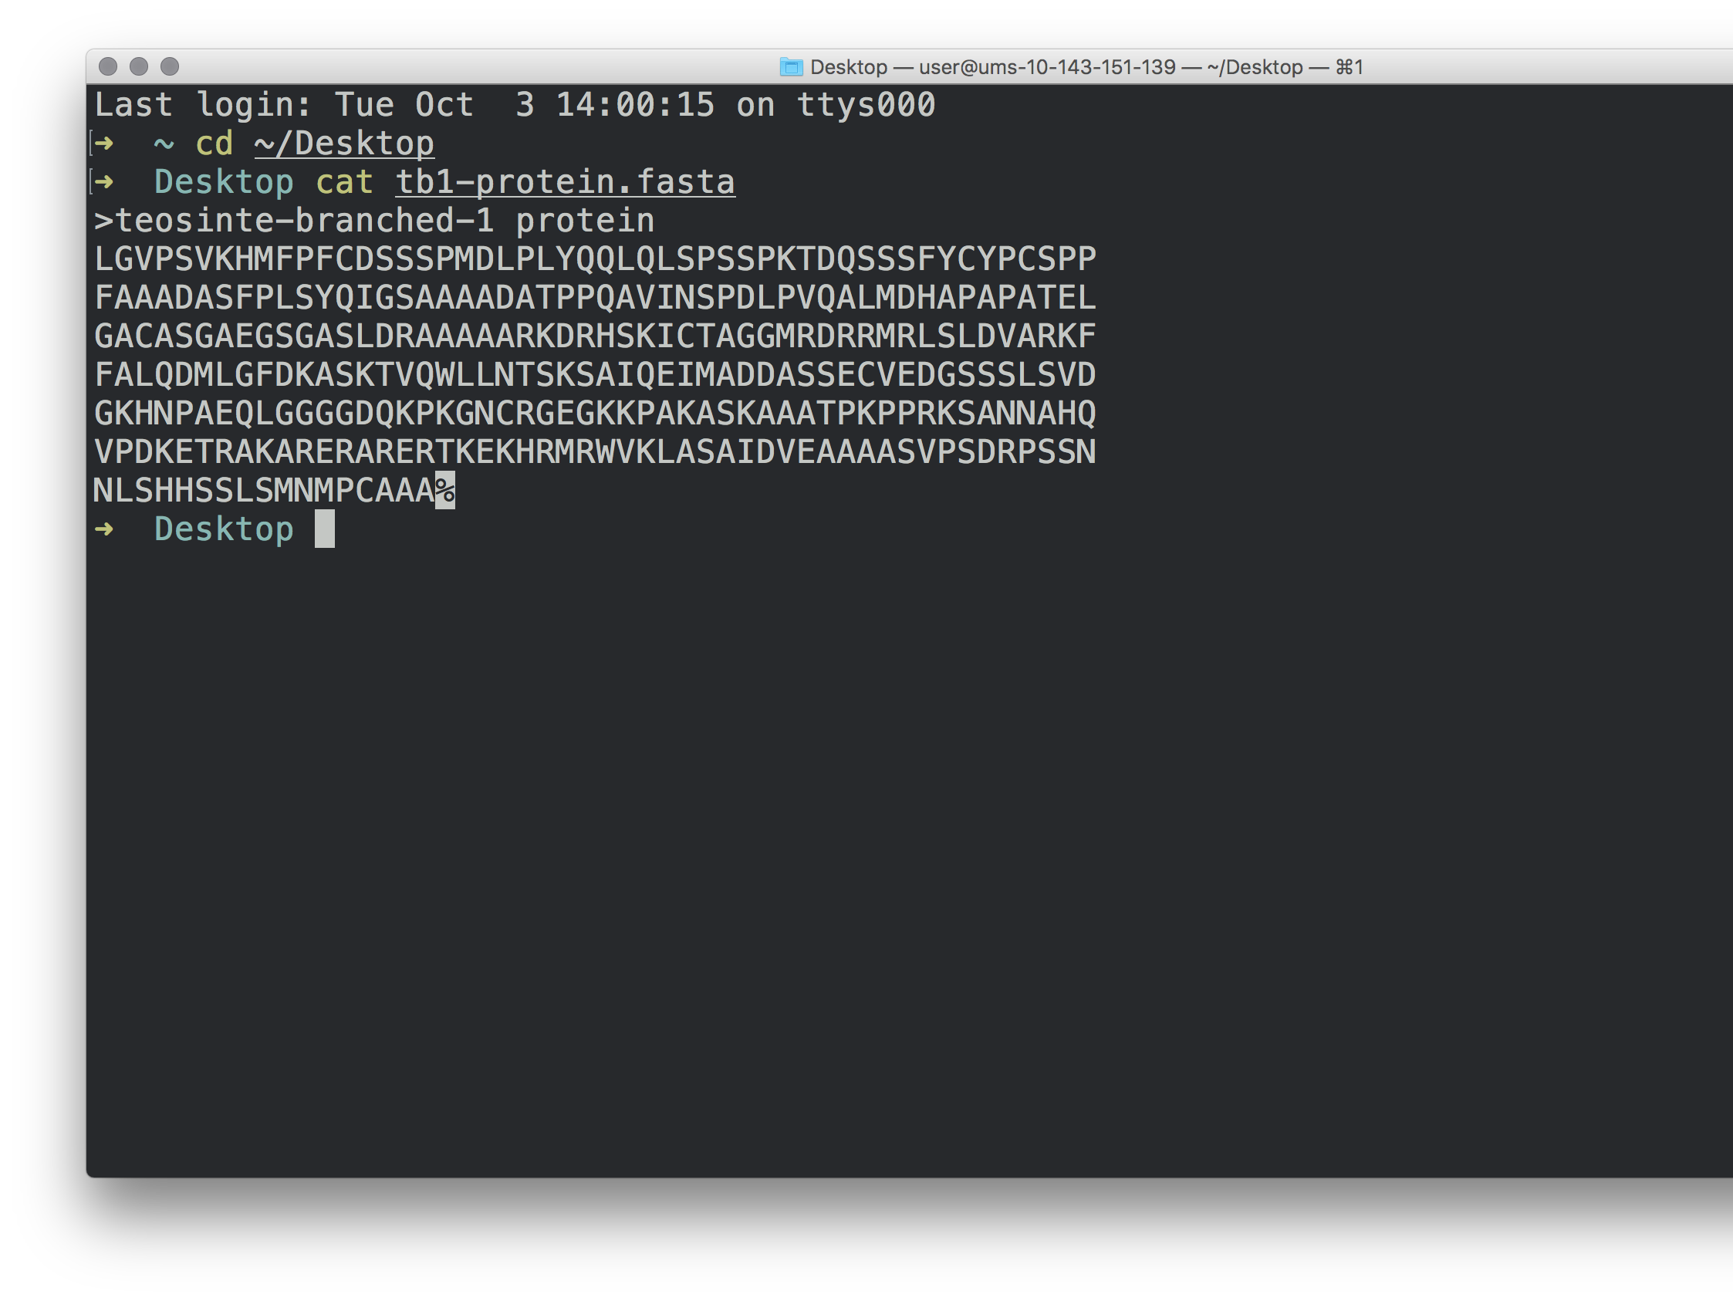
The cat command reads one or more files and prints their contents to standard output.

Slide 10
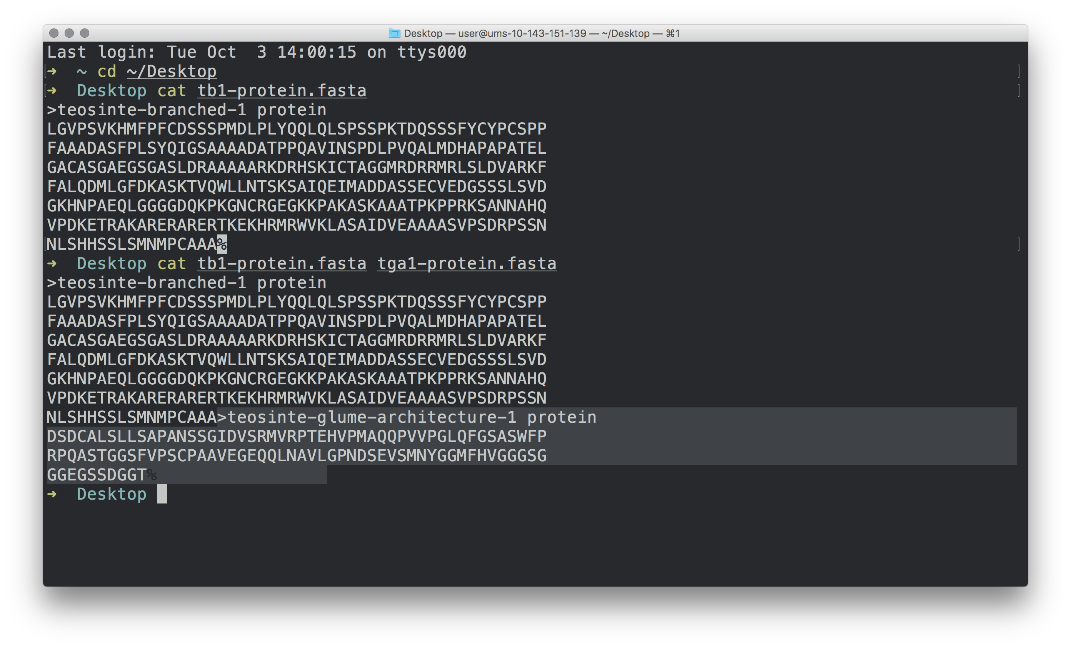
cat also prints multiple files’ contents to the standard output stream

Slide 11
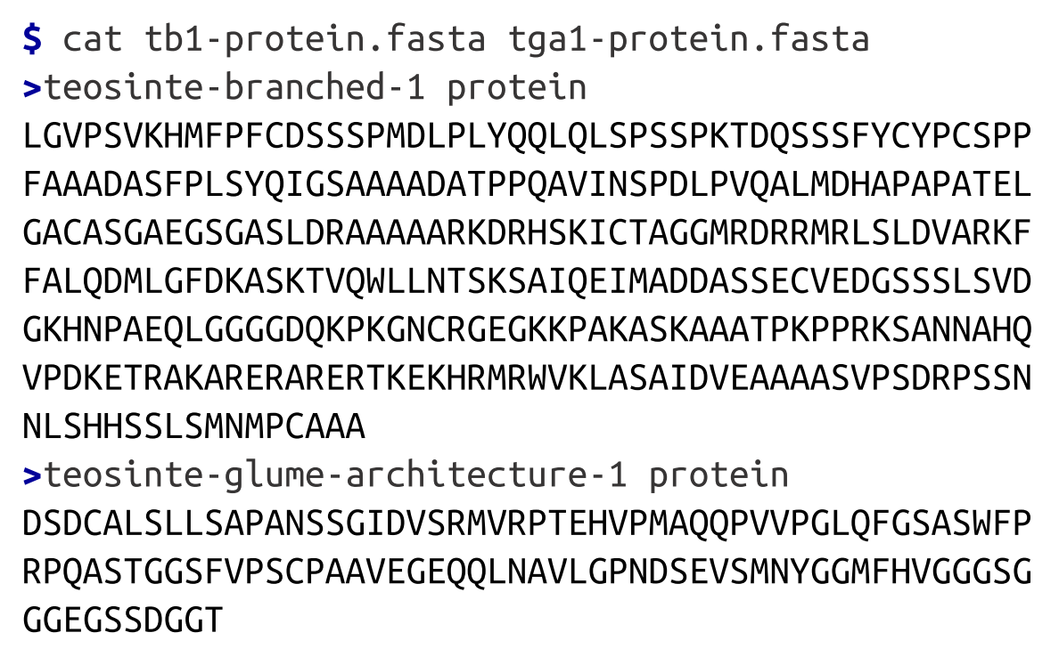
cat also prints multiple files’ contents to the standard output

Slide 12
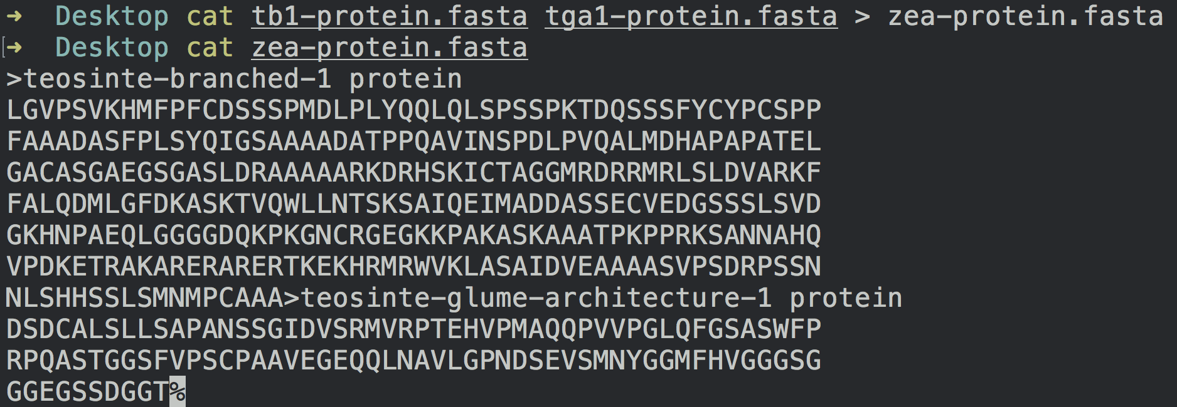

>

Slide 13
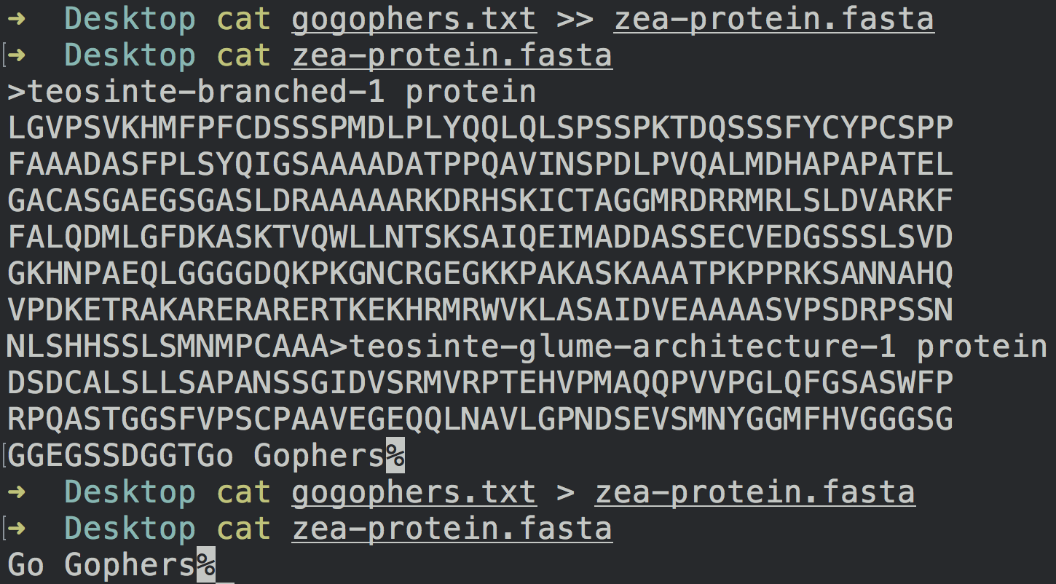
>>

Slide 14
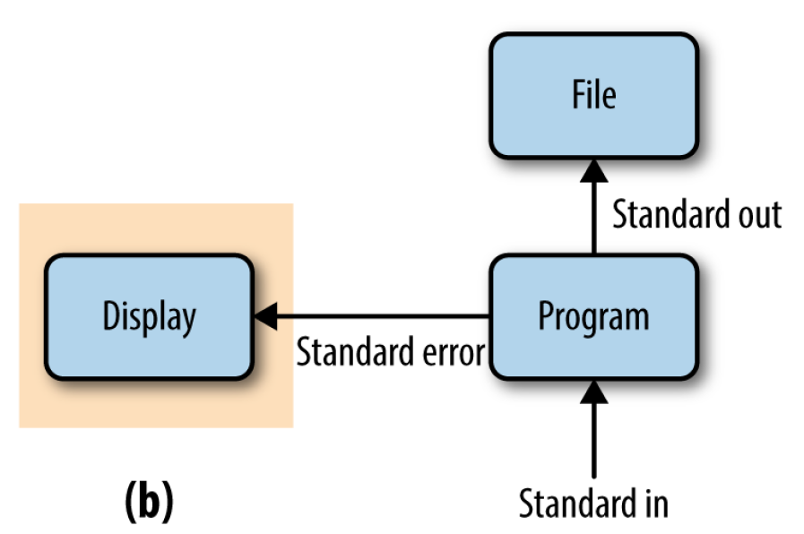

Slide 15
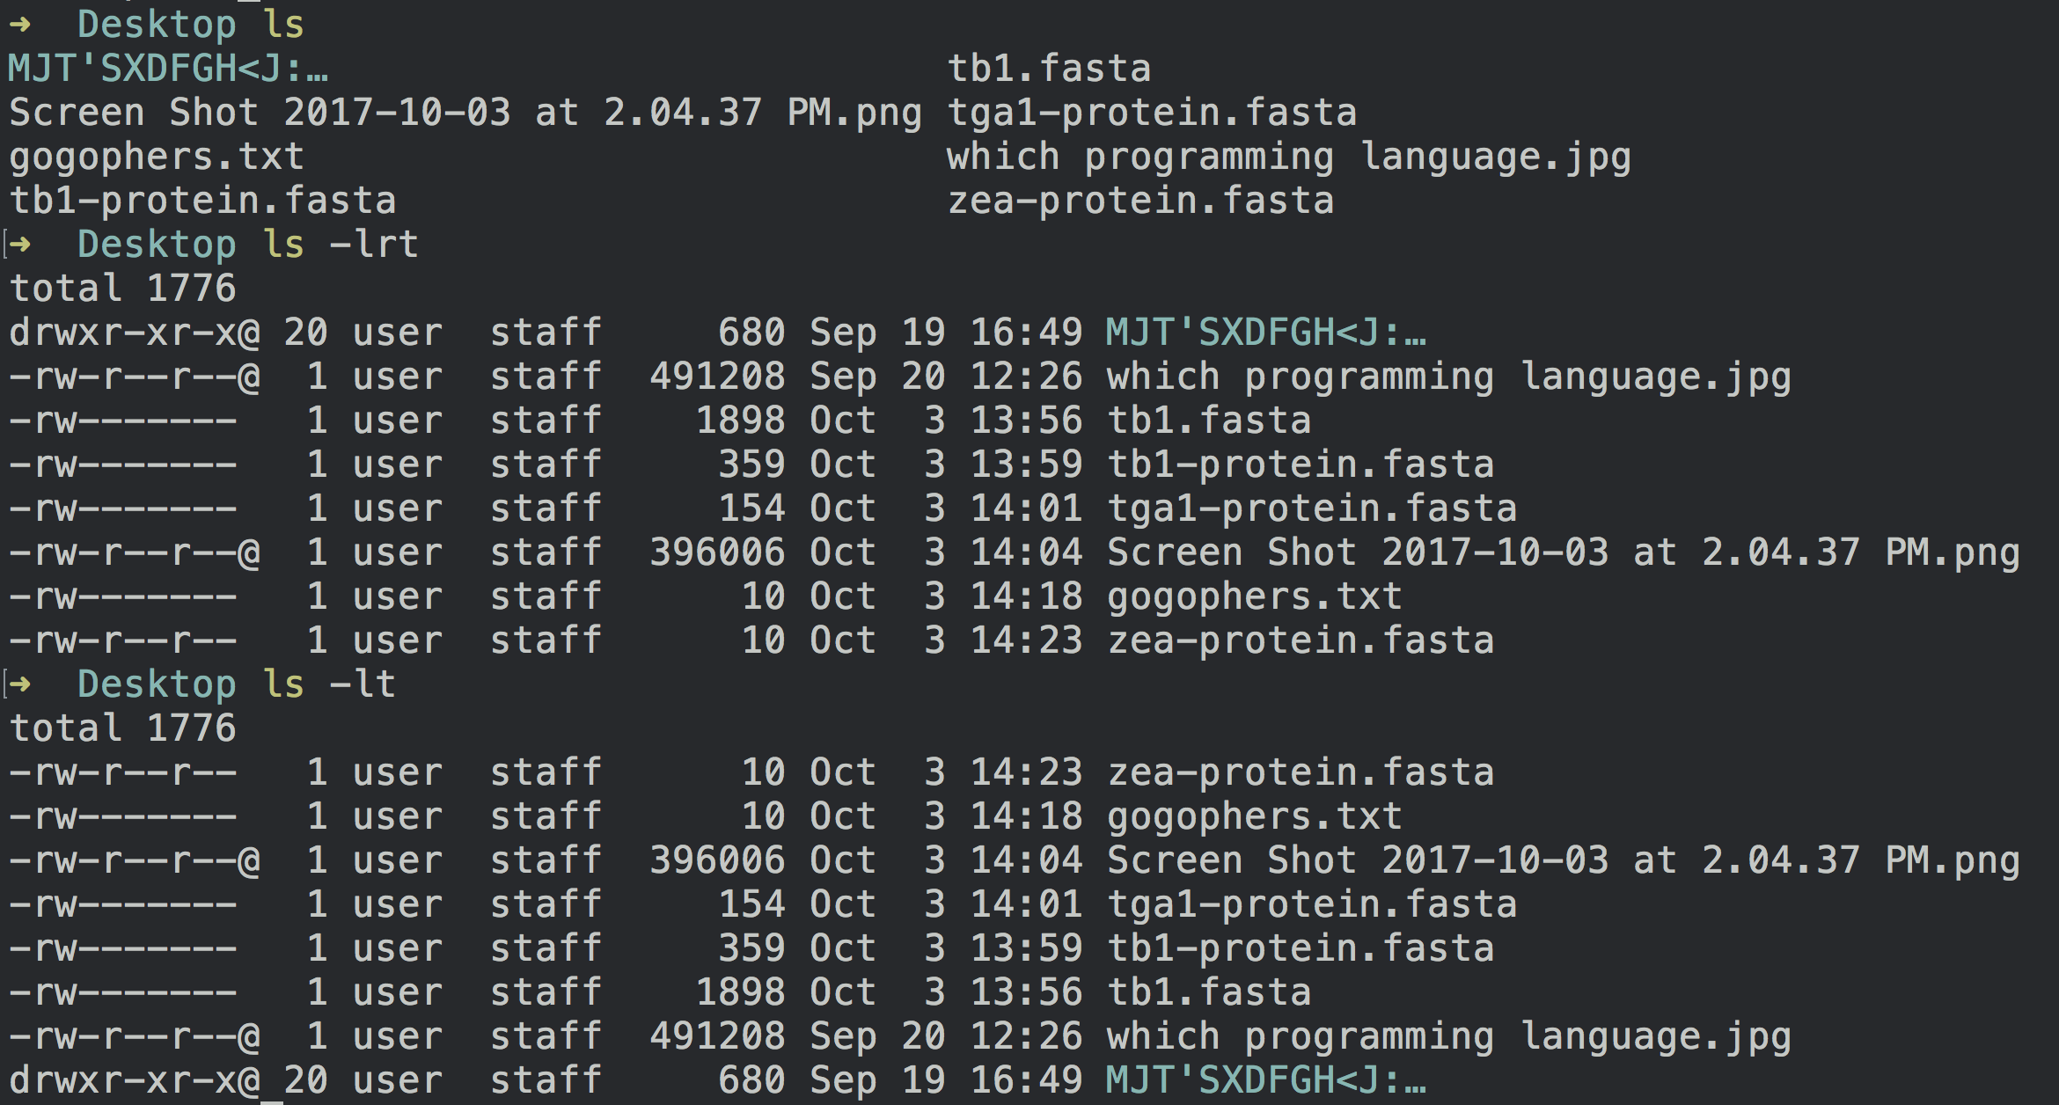
Check the most recent file created

Slide 16
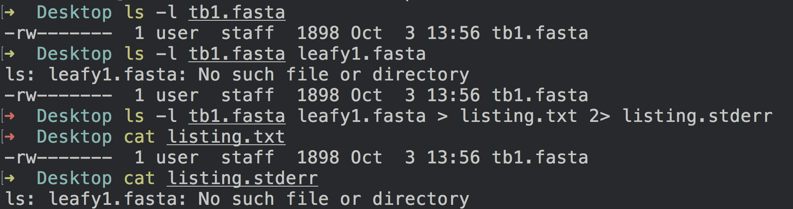
2> Redirecting Standard Error
Stderr file

Slide 17

Using Standard Input Redirection

Slide 18
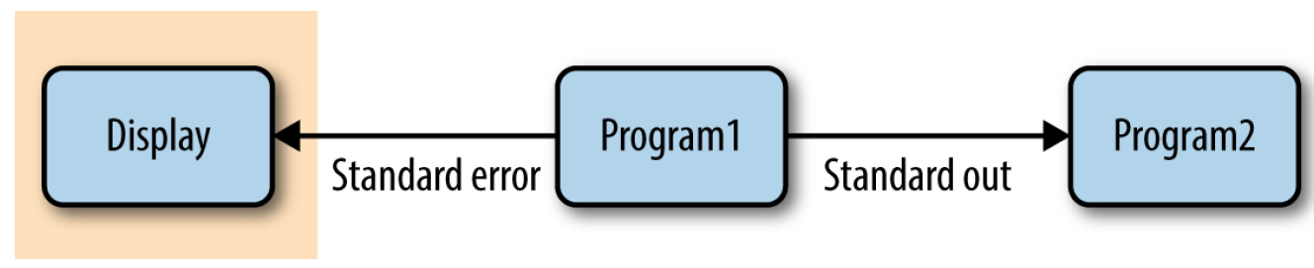
The Almighty Unix Pipe: Speed and Beauty in One
computational efficiency—reading and writing to the disk is very slow.
unnecessarily redirecting output to a file uses up disk space.

Slide 19
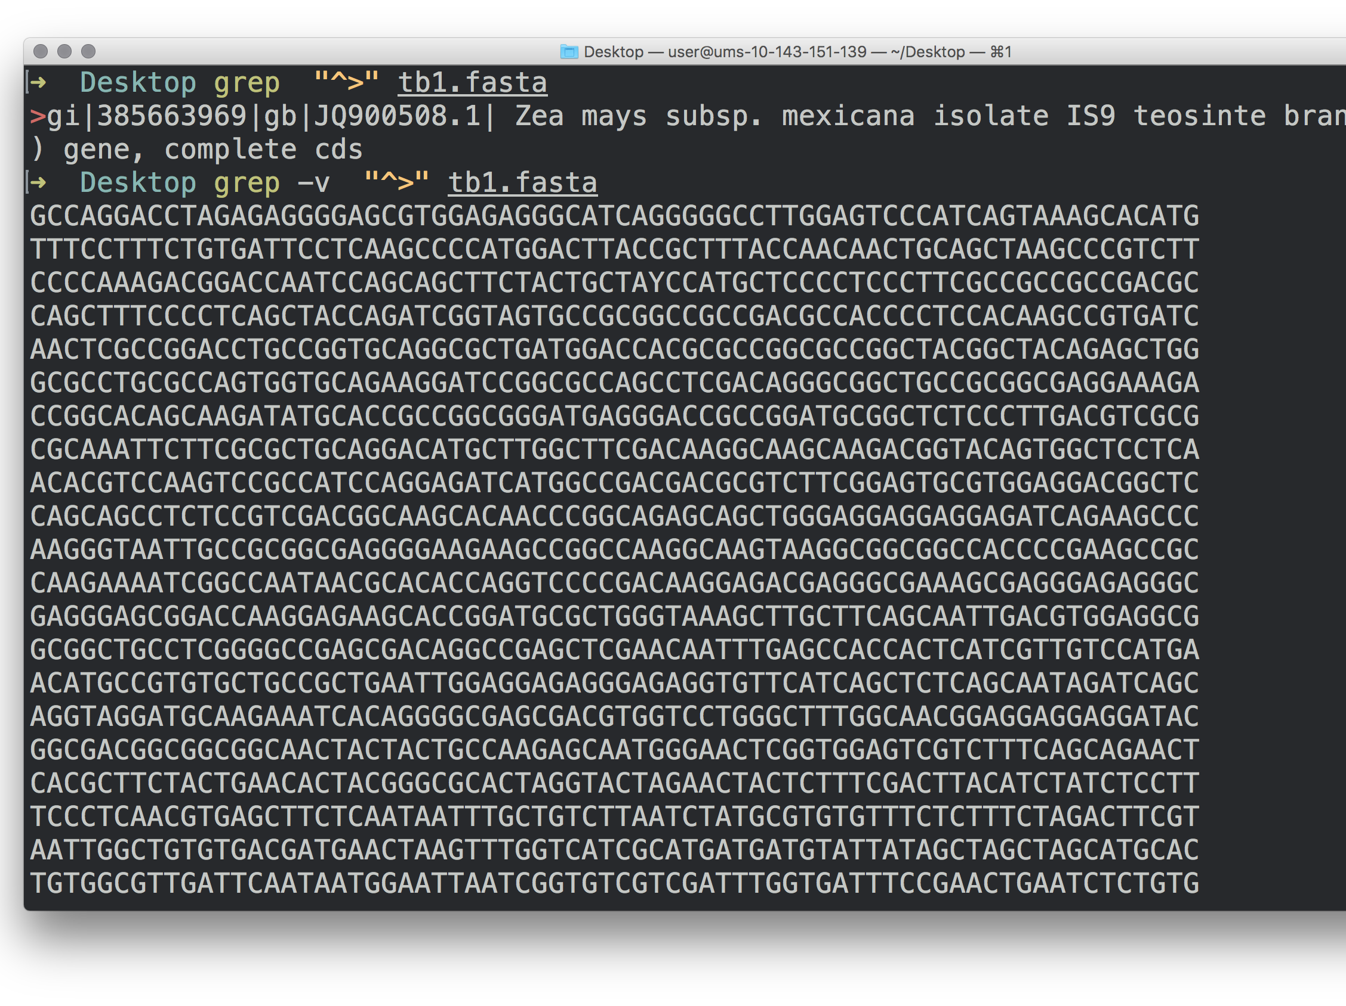
grep

Slide 20
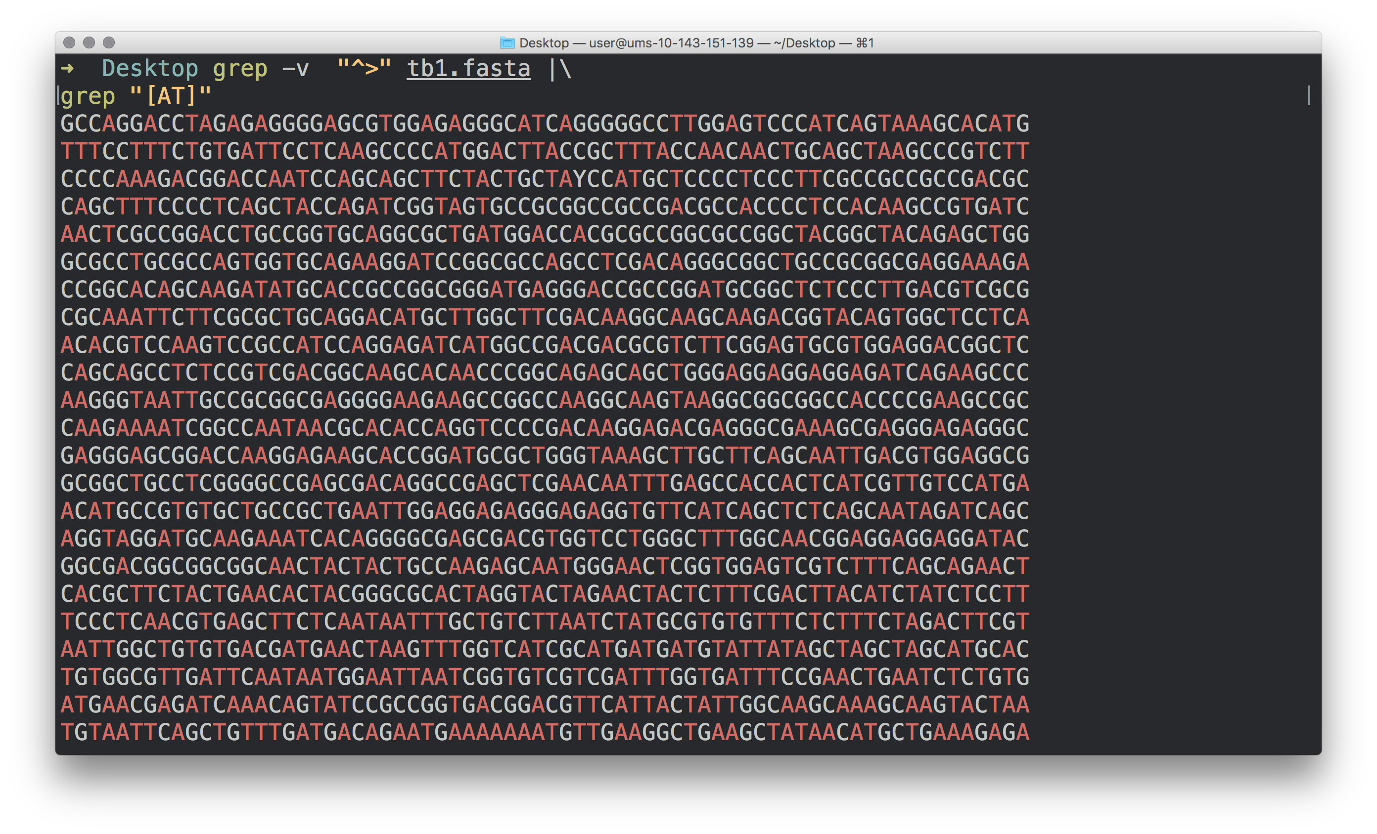

Slide 21
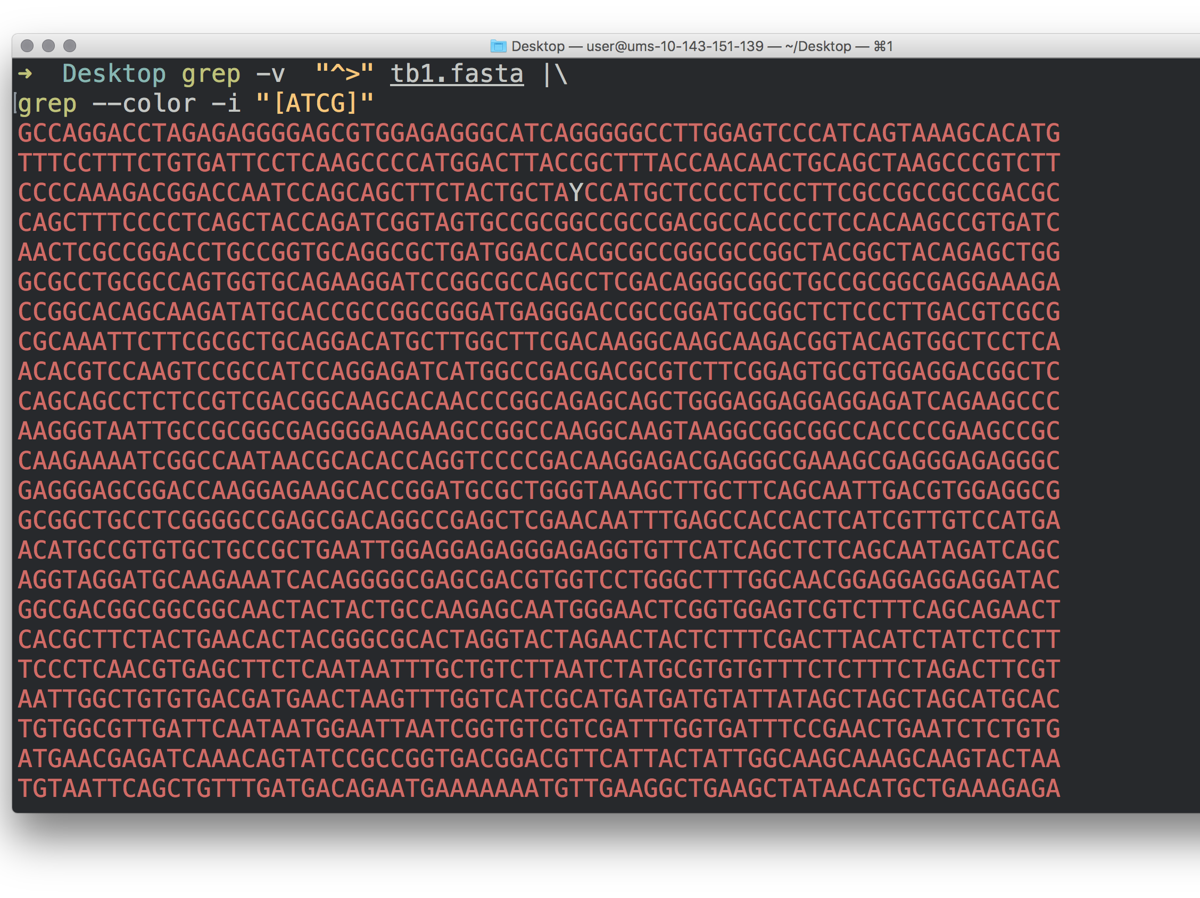

Slide 22
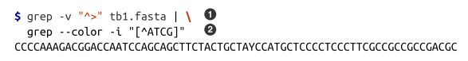
Pipes in Action: Creating Simple Programs with Grep and Pipes
The grep Unix tool searches files or standard input for strings that match patterns.
The caret symbol “^”> , matches all lines that start with a > character.
we invert the matching lines with the grep option -v .
pipe character ( | ).
The backslash ( \ ) character simply means that we’re continuing the com‐
mand on the next line, and is used above to improve readability.
When used in brackets, a caret symbol matches anything that’s not one of the characters in these brackets. So the pattern [^ATCG] matches any character that’s not A, T, C, G.

Slide 23
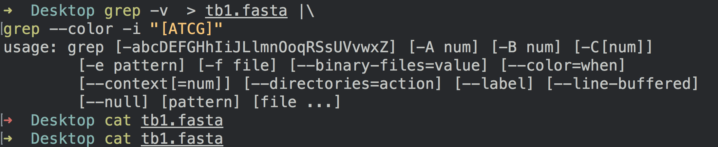
Attention!

Slide 24
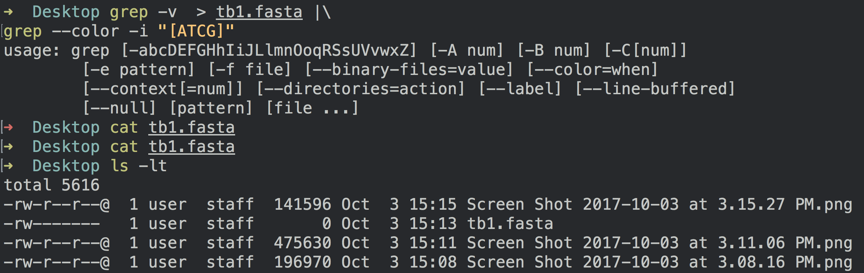
Attention!

Slide 25

Combining Pipes and Redirection
input.txt
program1
Standard out
program 2
Standard out
results.txt
Standard error
Standard error
program1.stderr
program2.stderr
A tee in Your Pipe
input.tx
program1
Standard out
program 2
Standard out
results.txt
intermediate-file.txt

Slide 26
Managing and Interacting with Processes
Background Processes
Killing Processes
Exit Status: How to Programmatically Tell Whether Your Command Worked

Slide 27
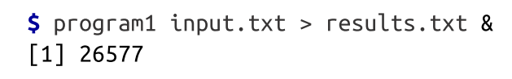
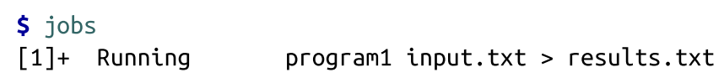
Background Processes
We can tell the Unix shell to run a program in the background by appending an ampersand ( & ) to the end of our command. For example:
the process ID or PID of program1
We can check what processes we have running in the background with jobs :

Slide 28
closing our terminal window would cause these processes to be killed. Unfortunately, a lot of long-running important jobs have been accidentally killed this way.

Slide 29
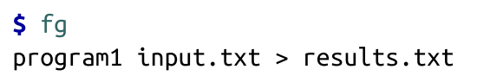
Background Processes
the process ID or PID of program1
To bring a background process into the foreground again, we can use fg
To return a specific background job to the foreground, use fg %<num> where <num> is its number in the job list.
Here, fg and fg %1 would do the same work.

Slide 30
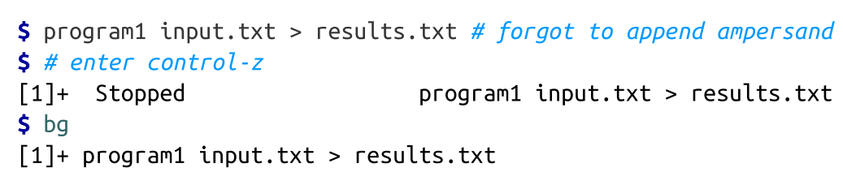
Place a process already running in the foreground into the background
Similarly, bg %<num>

Slide 31
Killing Processes
Control-C.
This only works if this process is running in the foreground.

Slide 32
Exit Status: How to Programmatically Tell Whether Your Command Worked
A subsequent command in a chain is run conditionally on the last command’s exit status.
Unix programs exit with an exit status, which indicates whether a program terminated without a problem or with an error. By Unix standards, an exit status of 0 indicates the process ran successfully, and any nonzero status indicates some sort of error has occurred
(and hopefully the program prints an understandable error message, too).

Slide 33
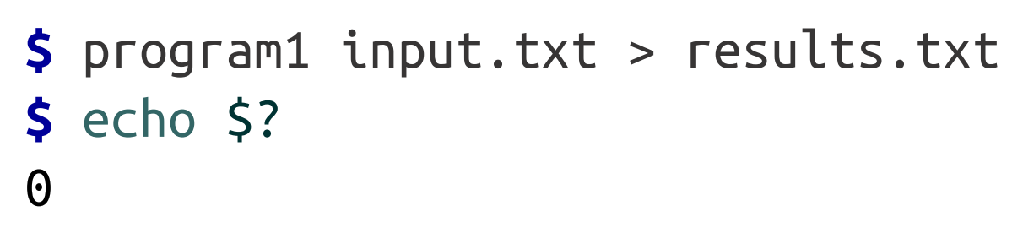
Exit Status How to Programmatically Tell Whether Your Command Worked
The exit status isn’t printed to the terminal, but your shell will set its value to a variable in your shell (aptly named a shell variable) named $?
We can use the echo command to look at this variable’s value after running a command

Slide 34

bash operators: && vs ||

Slide 35
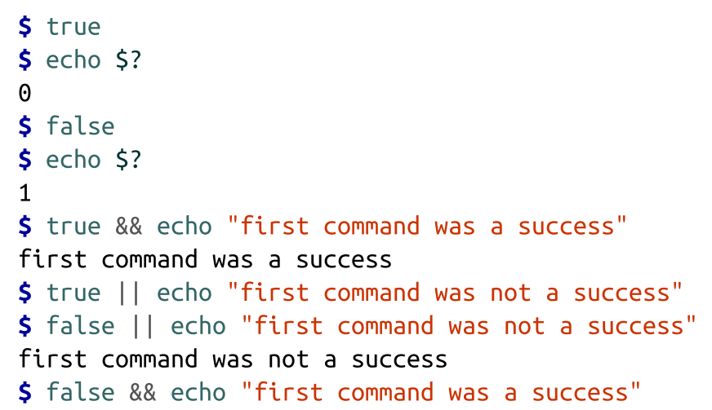
bash operators: && vs ||

Slide 36
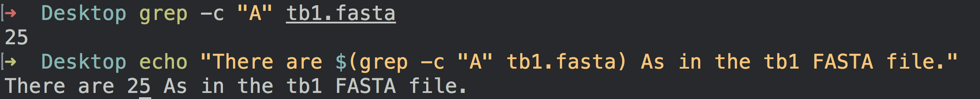
Command Substitution
Command substitution runs a Unix command inline and returns the output as a string that can be used in another command. This opens up a lot of useful possibilities.
the -c option stands for count

Slide 37
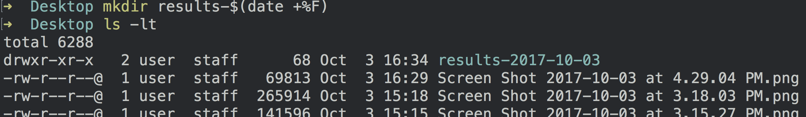
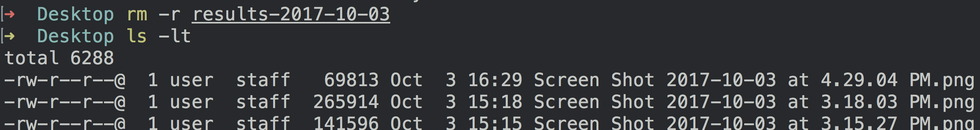
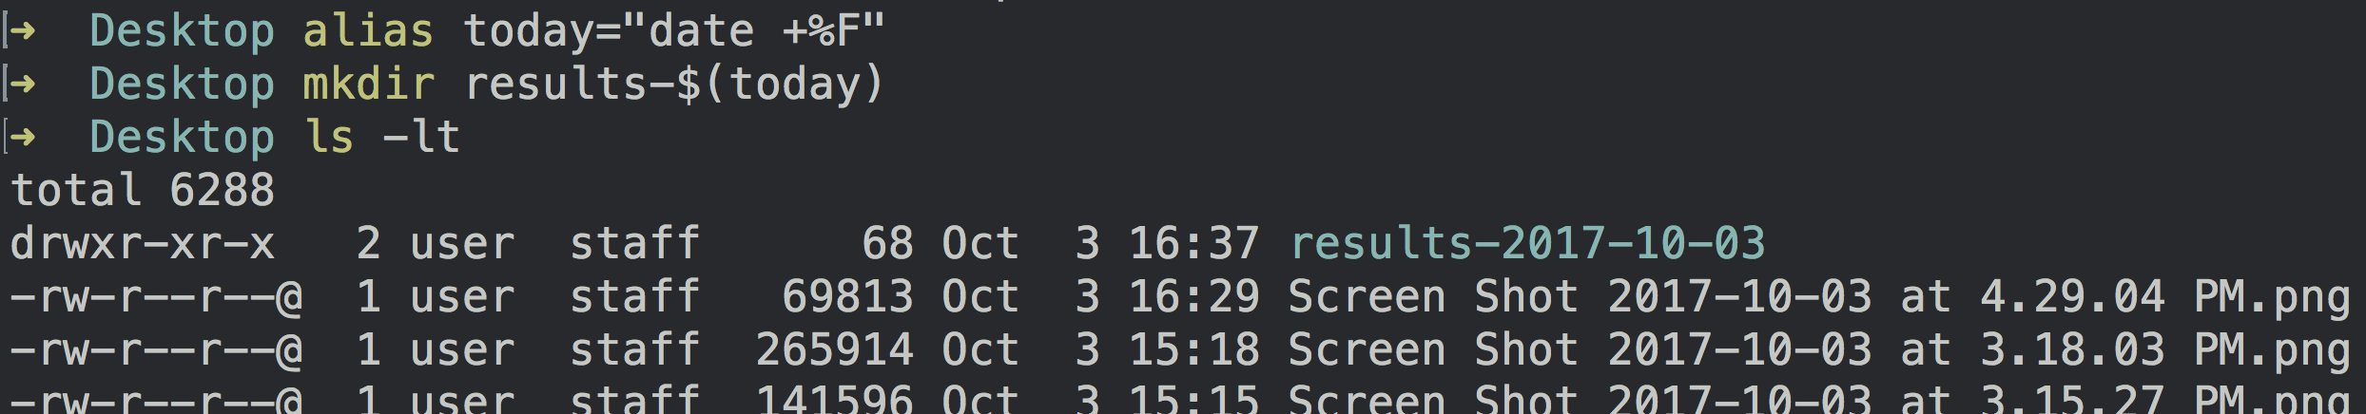
Alias
alias instructs the shell to replace one string with another when executing commands.

Slide 38
Working with Remote Machines

Slide 39
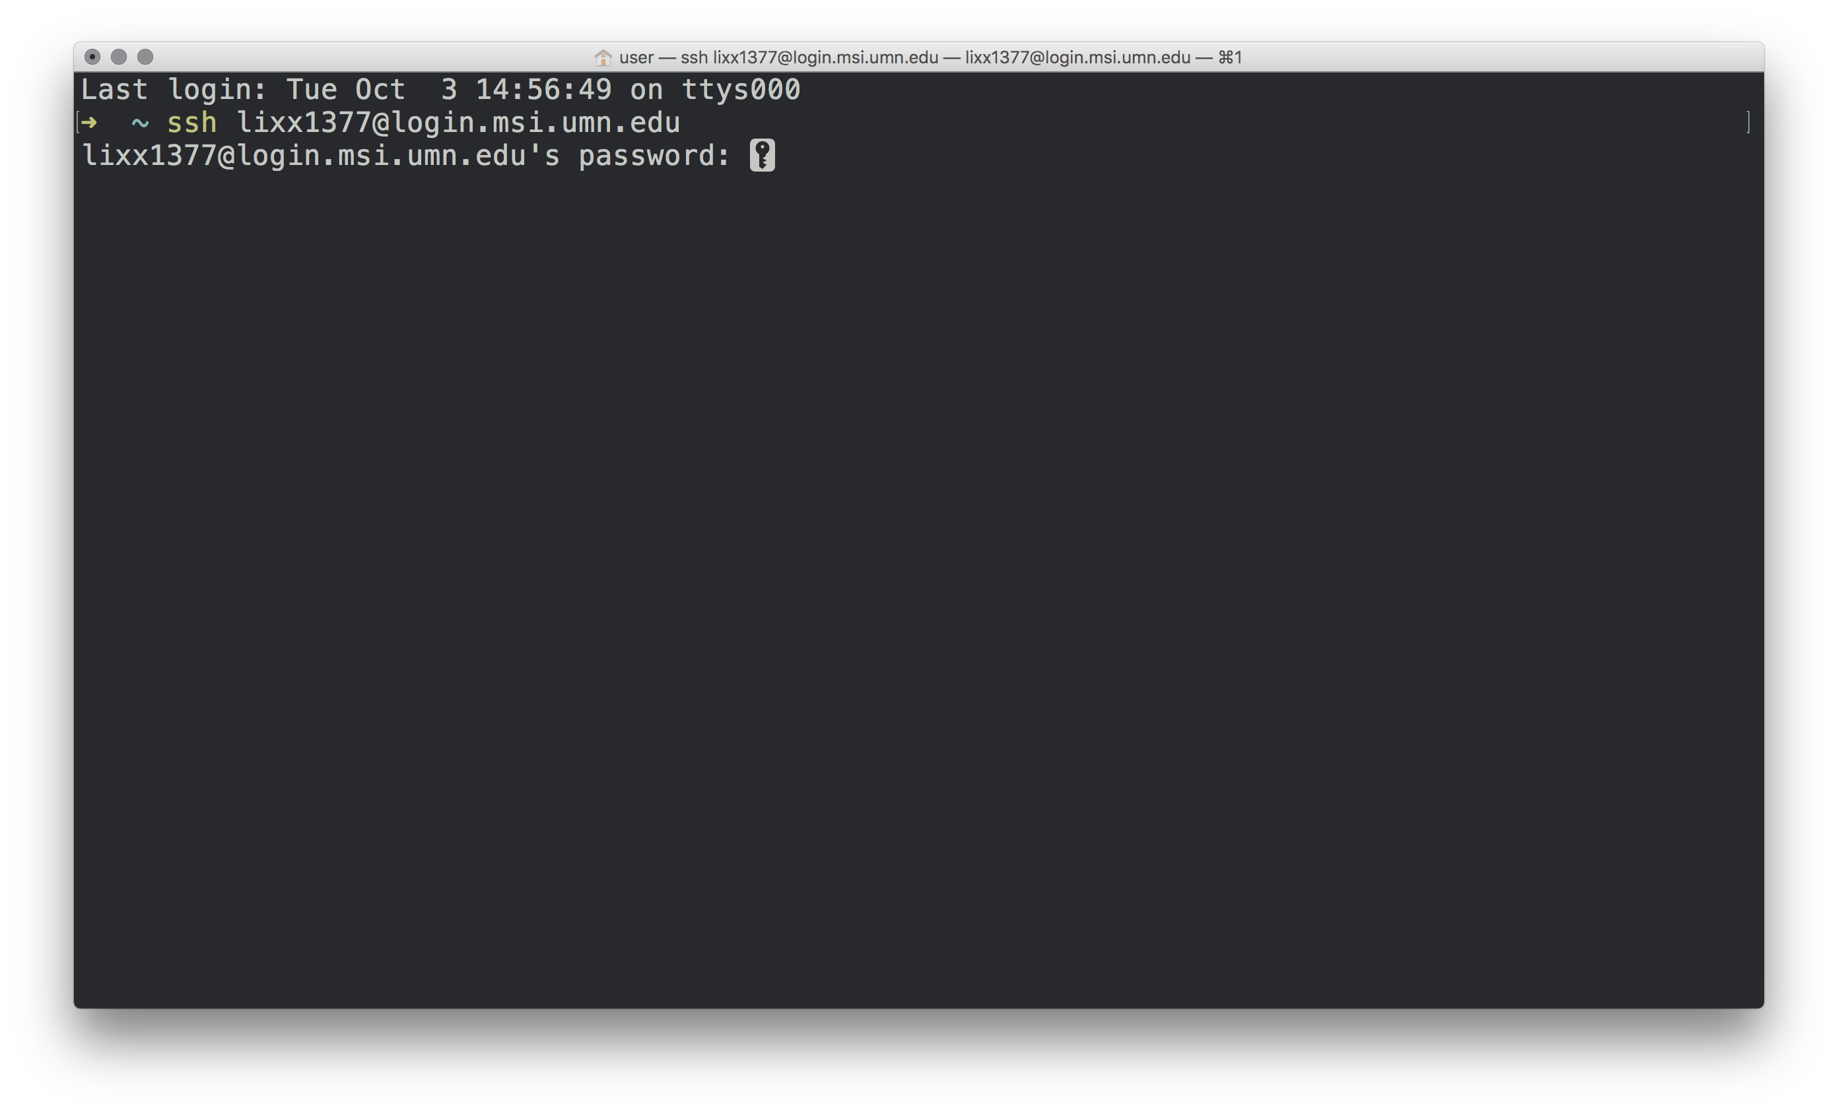
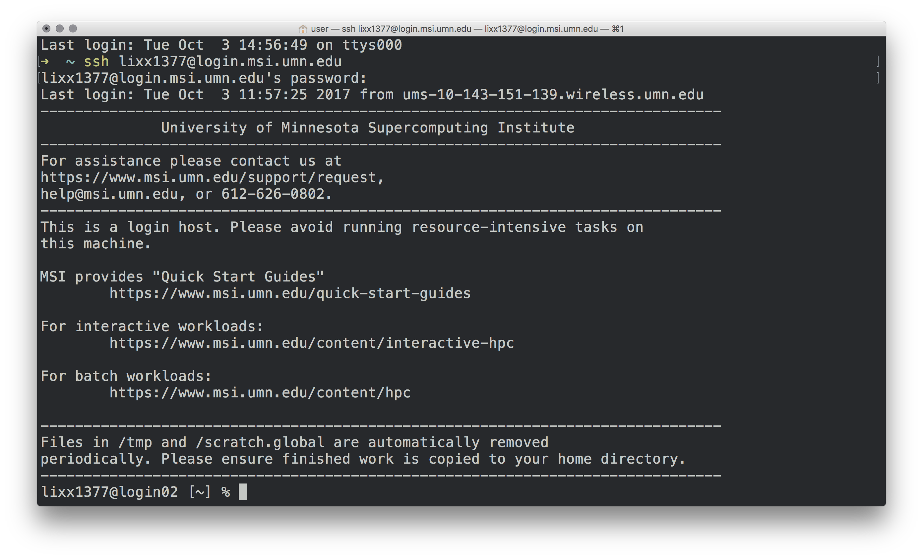
Connecting to Remote Machines with SSH

Slide 40
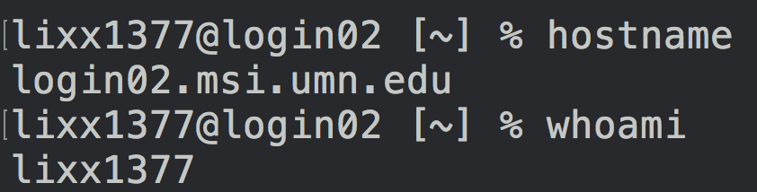
Hostname and whoami

Slide 41
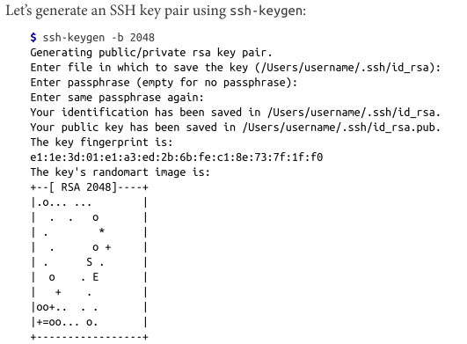
Quick Authentication with SSH Keys

Slide 42

Maintaining Long-Running Jobs with nohup and tmux
nohup

Slide 43
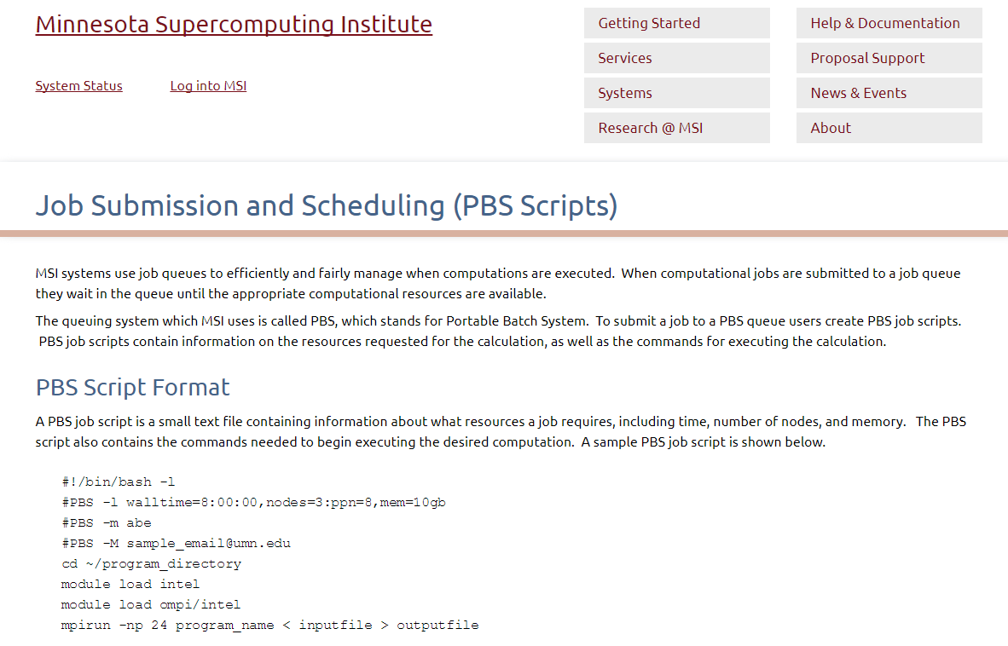
Working with Remote Machines Through Tmux
Notes:
Tmux is a Linux thing when you want to access multiple terminal sessions from the same terminal.
On MSI, we use their job scheduler and submit PBS scripts for long jobs. See more info here: https://www.msi.umn.edu/content/job-submission-and-scheduling-pbs-scripts
-Chaochih Liu

Slide 44

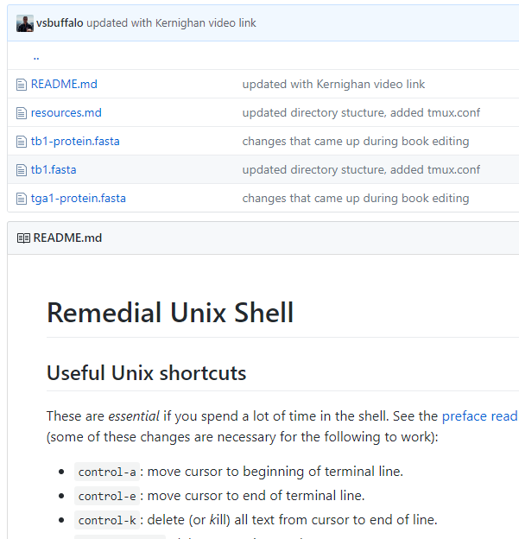
Useful info
https://github.com/vsbuffalo/bds-files

Slide 45

https://www.msi.umn.edu/getting-started

